Slide 1
ELECTRICITY CONSUMPTION ACROSS DIFFERENT CITIES
PREPARED BY:-
NAME:- PRAGATI AGGARWAL
ROLL NO. :- 2402009485/2423482
SUMMER TRAINING MAJOR PROJECT (DATA SCIENCE)
C.G.C. UNIVERSITY MOHALI

Slide 2
INTRODUCTION
Electricity is one of the most important resources for economic growth and urban development.
Electricity demand varies across cities due to differences in population, industrialization, climate, commercial activities, and seasonal changes.
This project analyzes electricity consumption patterns across multiple Indian cities using data analytics and Power BI to identify trends, compare regions, and support better energy planning.

Slide 3
OBJECTIVES
Analyze electricity consumption across different cities.
Compare residential, commercial, industrial, and agricultural consumption.
Study seasonal and yearly electricity demand.
Identify cities with maximum and minimum electricity usage.
Analyze the impact of temperature and population on electricity consumption.
Evaluate renewable energy contribution.
Build an interactive Power BI dashboard for decision-making.

Slide 4
DATASET OVERVIEW
FEATURE | DETAILS
DATASET SIZE | 1200 RECORDS
TOTAL COLUMNS | 23
CITIES COVERED | 25
STATES COVERED | 17
TIME PERIOD | 2021-2024 (MONTHLY)
MISSING VALUES | NONE
DATA TYPE | STRUCTURED CSV / XLSX

Slide 5
IMPORTANT COLUMNS
City
State
Region
Population
Season
Average Temperature
Residential Consumption
Commercial Consumption
Industrial Consumption
Agricultural Consumption
Total Consumption
Peak Demand
Tariff Rate
Power Outage Hours
Renewable Energy Share
Electrification Rate

Slide 6
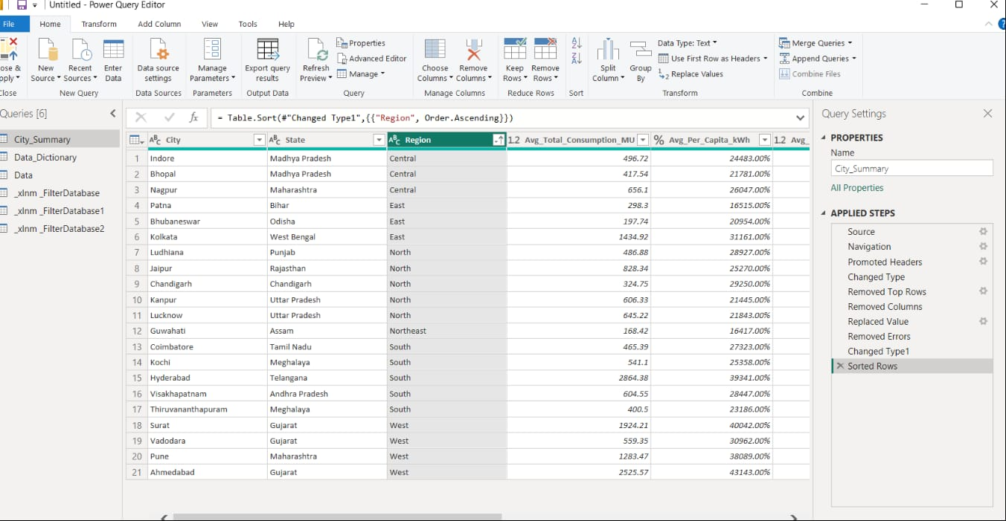
Data CLEANING
Step 1 :- Removed the top 4 rows from the avg_total_consumption_MU.
Step 2 :- Removed the column city tier.
Step 3 :- Replace the value in state column from kerala to meghalaya.
Step 4 :- removed error from city column.
Step 5 :- change the datatype of column avg_per_capita_kwh from decimal number to percentage.
Step 6 :- sort the data to ascending order in region column.

Slide 7
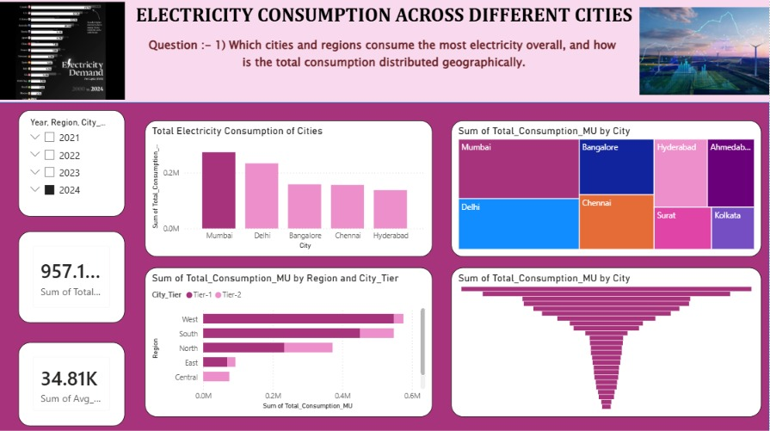
DASHBOARD QUESTION 1
THIS QUESTION REPRESENTS WHICH CITIES AND REGIONS CONSUME THE MOST ELECTRICITY OVERALL.
Mumbai has the highest electricity consumption with 273,067 MU.
Delhi ranks second with 232,987 MU.
Bangalore, Chennai, and Hyderabad also consume large amounts of electricity.
The West and South regions show the highest electricity consumption due to higher population, industrial activities, and commercial development.

Slide 8
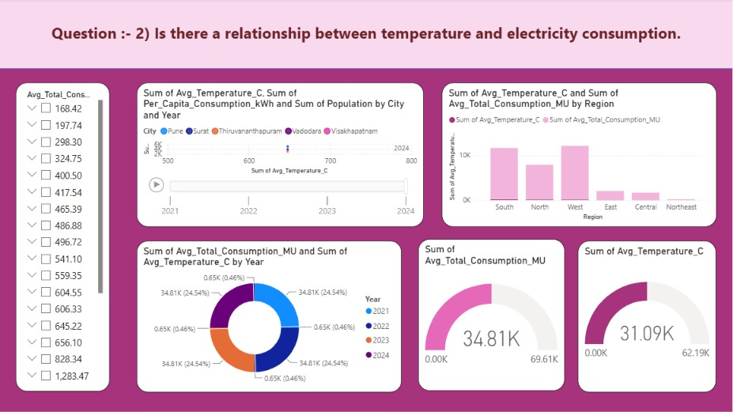
Dashboard question 2
This question represents the relationship between temperature and electricity consumption.
The analysis shows that electricity consumption generally increases as temperature rises, indicating that higher temperatures are associated with greater electricity demand.
As temperature increases, electricity consumption also increases.
The relationship is stronger for per-capita consumption than for total consumption because population size also influences total demand.

Slide 9
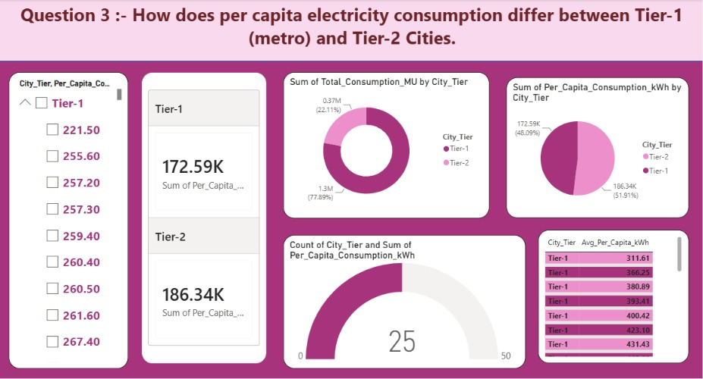
Dashboard question 3
This question represents how does per capita consumption differ between tier-1 and tier-2.
Tier-1 cities are larger metropolitan areas with greater industrial and commercial activities, while Tier-2 cities are smaller developing cities.
Tier-1 cities have significantly higher per-capita electricity consumption than Tier-2 cities due to greater urbanization, commercial activity, and industrial development.

Slide 10
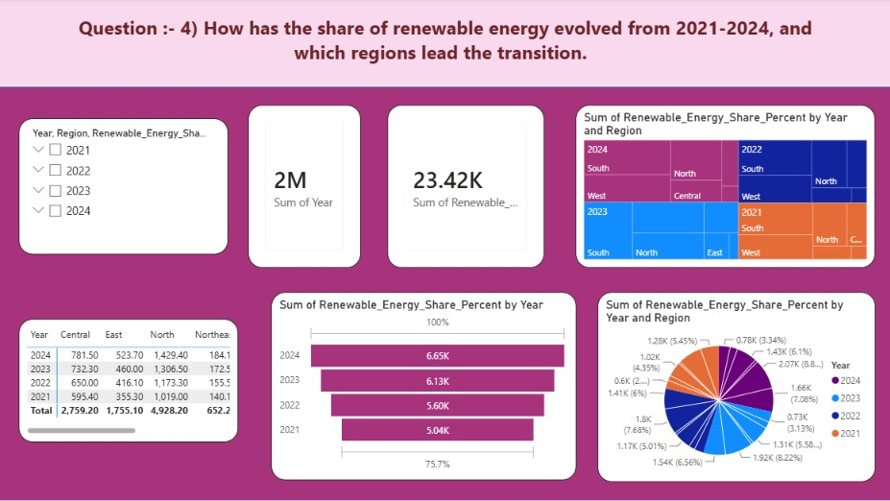
Dashboard question 4
This question represents how the share of renewable energy evolved from 2021-2024.
Renewable energy reduces pollution and dependence on fossil fuels. This analysis tracks the increase in renewable energy share over four years.
Renewable energy share shows a steady increase from 2021 to 2024.
The West and South regions have the highest renewable energy share.

Slide 11
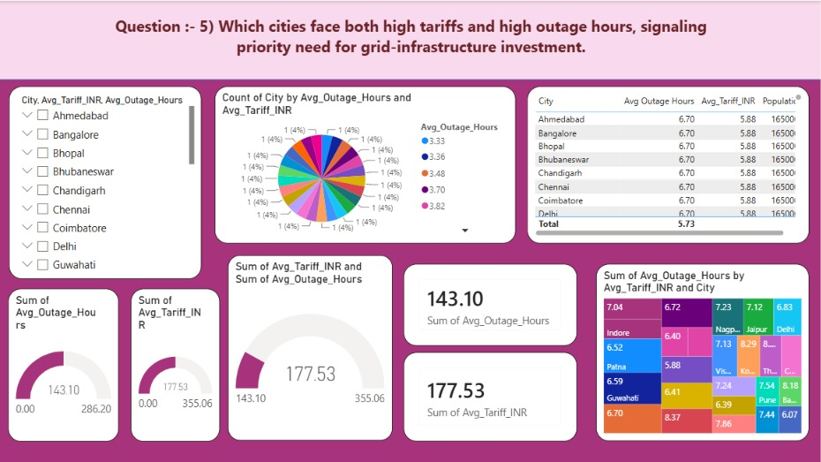
Dashboard question 5
This question represents the cities facing both high tariffs and high outage hours.
Cities with higher tariffs generally experience fewer power outages, indicating better service reliability.
Cities with higher outage hours tend to have moderate or lower tariff rates.
No city in the dataset shows both extremely high tariffs and extremely high outage hours.
This suggests that higher electricity tariffs are generally associated with a more reliable power supply.

Slide 12
Key insights
Total records analyzed: 1,200
Cities analyzed: 25
States represented: 17
Average total electricity consumption: 1,392.23 MU
Maximum total consumption: 8,230.23 MU
Minimum total consumption: 140.17 MU
Average electrification rate: 98.09%
Average renewable energy share: about 30% (from dataset values)
Large metropolitan cities consume significantly more electricity than smaller cities.
Industrial and residential sectors contribute the largest share of electricity consumption.
Electricity demand increases during high-temperature months.
Higher population generally leads to higher electricity consumption.

Slide 13
conclusion
This project successfully analyzed electricity consumption across different Indian cities using Power BI and data analytics. The analysis revealed significant variations in electricity demand based on population, industrial activity, climate, and seasonal factors. The interactive dashboard enables stakeholders to monitor consumption trends, compare regions, and make informed decisions. The project demonstrates how data visualization and business intelligence can support efficient energy management and sustainable electricity planning.

Slide 14
Thank you

